Slide 1
Chapter 3 Fourier Series

Slide 2
Introduction
Problems involving various forms of oscillations are common in the fields of modern technology and Fourier series, with which we shall now be concerned enable us to represent a periodic function as an infinite trigonometrical series in sine and cosine.

Slide 3
Fourier Series
Given that certain conditions are satisfied then it is possible to write a periodic function of period 2$π$ as a series expansion of the orthogonal periodic functions. If f (x) is defined on the interval $−π≤x≤π$ where f (x + 2n$π)$ = f (x) then
$$f (x) =\frac{a_{0}}{2}+ \sum_{n=1}^{∞}{(a_{n}\cos{nx+b_{n}\sin{nx}})}$$
This is the Fourier Series Expansion of f(x) where the a_{n} and b_{n} are constants called Fourier coefficients.
We can find these constants using mutual orthogonality of the trigonometric functions in the expansion.

Slide 4
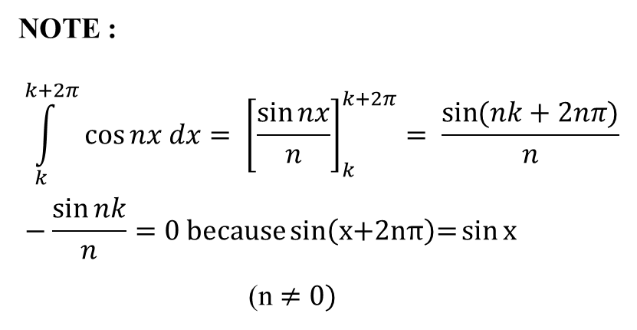
Integrals of periodic functions
$\int_{−π}^{π}{dx}= {\left[x\right]}_{−π}^{π}=2π$
2. $\int_{−π}^{π}{\cos{nx}dx}= 0$
3. $\int_{−π}^{π}{\sin{nx}dx}= 0$
4. $\int_{−π}^{π}{\cos{mx\cos{nx}}dx}= π δ_{mn}=\{_{0 if m ≠n}^{1 if m=n}$ ($δ_{mn} is called the kronecker delta$)
5. $\int_{−π}^{π}{\sin{mx\sin{nx}}dx}= π δ_{mn}$ ($δ_{mn} is called the kronecker delta$)
6. $\int_{−π}^{π}{\cos{mx\sin{nx}}dx}= 0$
NOTE :
$$\int_{k}^{k+2π}{\cos{nx dx= {\left[\frac{\sin{nx}}{n}\right]}_{k}^{k+2π}}= \frac{\sin{(nk+2nπ)}}{n}}−\frac{\sin{nk}}{n}=0 \text{because}\text{sin}\left(\text{x}\text{+2}\text{nπ}\right)\text{=}\text{sin}{\text{x}}$$
(n $≠0)$

Slide 5
Orthogonal functions
If two different functions f(x) and g(x) are defined on the interval a ≤ x ≤ b and
$$\int_{a}^{b}{f\left(x\right)g\left(x\right)dx=0 }$$
then we say that the two functions are orthogonal to each other on the interval a ≤ x ≤ b.

Slide 6
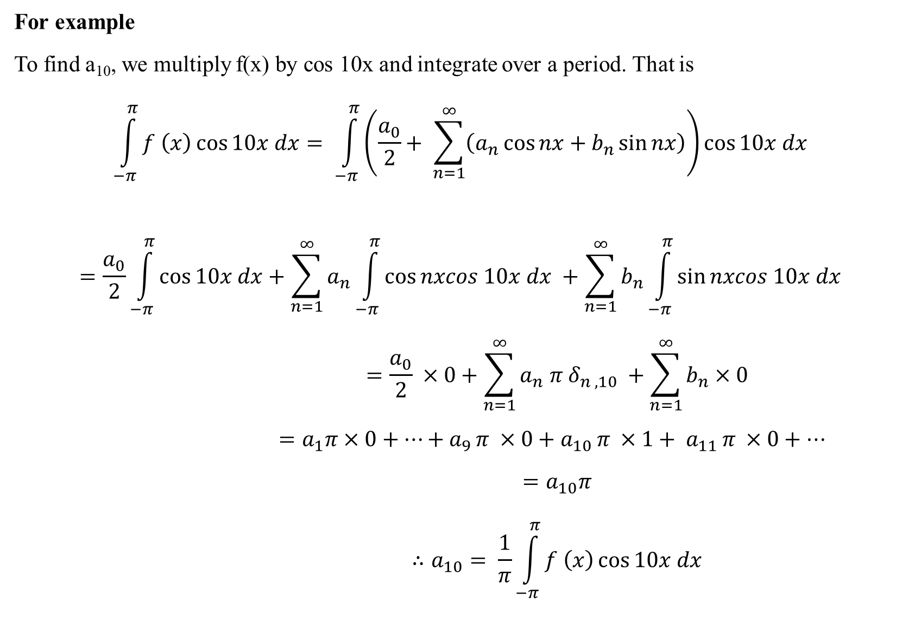
For example
To find a₁₀, we multiply f(x) by cos 10x and integrate over a period. That is
$$\int_{−π}^{π}{f \left(x\right)\cos{10x dx}}= \int_{−π}^{π}{\left(\frac{a_{0}}{2}+ \sum_{n=1}^{∞}{\left(a_{n}\cos{nx+b_{n}\sin{nx}}\right)}\right)\cos{10x dx}}$$
$$=\frac{a_{0}}{2}\int_{−π}^{π}{\cos{10x dx+\sum_{n=1}^{∞}{a_{n}\int_{−π}^{π}{\cos{nxcos 10x dx}}} +\sum_{n=1}^{∞}{b_{n}\int_{−π}^{π}{\sin{nxcos 10x dx}}}}}$$
$$=\frac{a_{0}}{2} ×0+\sum_{n=1}^{∞}{a_{n} π δ_{n , 10}} +\sum_{n=1}^{∞}{b_{n}×0}$$
$$=a_{1}π×0+…+a_{9 }π ×0+a_{10 }π ×1+ a_{11 }π ×0+…$$
$$=a_{10}π$$
$$∴a_{10}= \frac{1}{π}\int_{−π}^{π}{f \left(x\right)\cos{10x dx}}$$

Slide 7

(// ly)
$$\int_{−π}^{π}{f \left(x\right)\cos{mx dx=}}\int_{−π}^{π}{\left(\frac{a_{0}}{2}+ \sum_{n=1}^{∞}{\left(a_{n}\cos{nx+b_{n}\sin{nx}}\right)}\right)\cos{mx dx}}$$
$$=\frac{a_{0}}{2}\int_{−π}^{π}{\cos{mx dx+\sum_{n=1}^{∞}{a_{n}\int_{−π}^{π}{\cos{nxcos mx dx}}} +\sum_{n=1}^{∞}{b_{n}\int_{−π}^{π}{\sin{nxcos mx dx}}}}}$$
$$=\frac{a_{0}}{2} ×0+\sum_{n=1}^{∞}{a_{n} π δ_{n , m}} +\sum_{n=1}^{∞}{b_{n}×0}$$
$$=a_{m}π$$
$$∴a_{m}= \frac{1}{π}\int_{−π}^{π}{f \left(x\right)\cos{mx dx}}$$

Slide 8

Again
$$\int_{−π}^{π}{f \left(x\right)\sin{mx dx=}}\int_{−π}^{π}{\left(\frac{a_{0}}{2}+ \sum_{n=1}^{∞}{\left(a_{n}\cos{nx+b_{n}\sin{nx}}\right)}\right)\sin{mx dx}}$$
$$=\frac{a_{0}}{2}\int_{−π}^{π}{\sin{mx dx+\sum_{n=1}^{∞}{a_{n}\int_{−π}^{π}{\cos{nx sin mx dx}}} +\sum_{n=1}^{∞}{b_{n}\int_{−π}^{π}{\sin{nx sin mx dx}}}}}$$
$$=\frac{a_{0}}{2} ×0+\sum_{n=1}^{∞}{a_{n} ×0} +\sum_{n=1}^{∞}{b_{n}×π δ_{n , m}}$$
$$=b_{m}π$$
$$∴b_{m}= \frac{1}{π}\int_{−π}^{π}{f \left(x\right)\sin{mx dx}}$$

Slide 9
DIRICHLET CONDITIONS
If a function f(x) is such that
(a) f(x) is defined, single-valued and periodic with period 2
(b) f (x) and f′(x) have at most a finite number of finite discontinuities over a single period that is they are piecewise continuous.
Then the series is

Slide 10
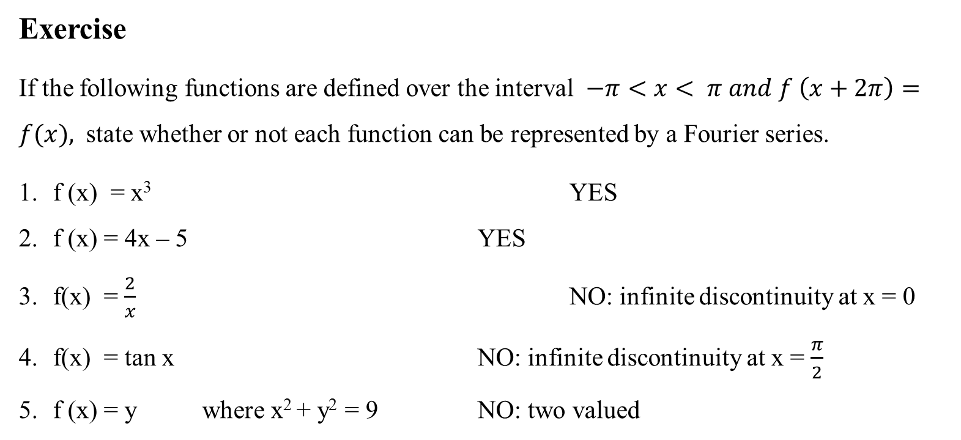
Exercise
If the following functions are defined over the interval $−π<x< π and f \left(x+2π\right)=f(x),$ state whether or not each function can be represented by a Fourier series.
f (x) = x³ YES
f (x) = 4x – 5 YES
f(x) = $\frac{2}{x}$ NO: infinite discontinuity at x = 0
f(x) = tan x NO: infinite discontinuity at x = $\frac{π}{2}$
f (x) = y where x² + y² = 9 NO: two valued

Slide 11
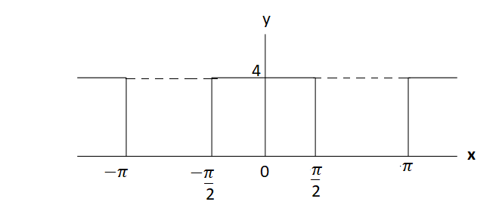
Example 1
Find the Fourier series for the function shown consider one circle between x = -π and x = π.
y
The function can be defined by
$$f(x)=\left\{\begin{aligned}& 0 −π<x≤−π/2 \\ & 4 −π/2 <x< π/2 \\ & 0 \frac{π}{2} <x< π\end{aligned}\right.$$

Slide 12

To find a₀
$$f(x) =\frac{a_{0}}{2}+ \sum_{n=1}^{∞}{\left\{a_{n}\cos{nx+b_{n}\sin{nx}}\right\}} \\ = \frac{1}{π}\int_{−π}^{π}{f\left(x\right)dx}$$
$$= \frac{1}{π}\left\{\int_{−π}^{−\frac{π}{2}}{0 dx}+\int_{\frac{−π}{2}}^{\frac{π}{2}}{4x dx}+\int_{\frac{π}{2}}^{π}{0 dx}\right\}$$
$$= \frac{1}{π}{\left[4x\right]}_{−\frac{π}{2}}^{\frac{π}{2}} = \frac{1}{π}\left(2π+2π\right)= \frac{1}{π}×4π=4$$

Slide 13
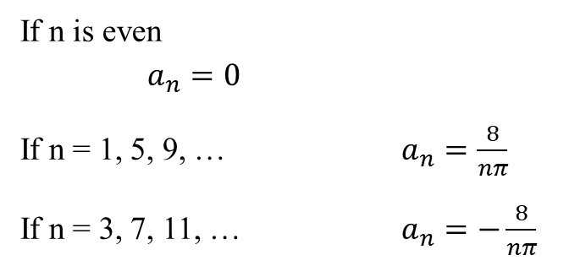

To find a_{n}
$$a_{n} = \frac{1}{π}\int_{−π}^{π}{f\left(x\right)\cos{nx }dx}$$
$$= \frac{1}{π}\left\{\int_{−π}^{−\frac{π}{2}}{0\cos{nx}dx}+\int_{\frac{−π}{2}}^{\frac{π}{2}}{4\cos{nx} dx}+\int_{\frac{π}{2}}^{π}{(0)cos{nx} dx}\right\}$$
$$= \frac{4}{π}{\left[\frac{\sin{nx}}{n}\right]}_{−\frac{π}{2}}^{\frac{π}{2}} = \frac{4}{nπ}\left(\sin{\frac{nπ}{2}}+\sin{\frac{nπ}{2}}\right) ∵\sin\left(−x\right)= −\sin{x}$$
$$= \frac{4}{nπ}\left(2\sin{\frac{nπ}{2}}\right)= \frac{8}{nπ}sin\frac{nπ}{2}$$
$$a_{n}= \frac{8}{nπ}sin\frac{nπ}{2}$$
If n is even $a_{n}=0$
If n = 1, 5, 9, … $a_{n}=\frac{8}{nπ}$
If n = 3, 7, 11, … $a_{n}=−\frac{8}{nπ}$

Slide 14

To find b_{n}
$$b_{n} = \frac{1}{π}\int_{−π}^{π}{f\left(x\right)\sin{nx }dx}$$
$$= \frac{1}{π}\left\{\int_{−π}^{−\frac{π}{2}}{0\sin{nx}dx}+\int_{\frac{−π}{2}}^{\frac{π}{2}}{4\sin{nx} dx}+\int_{\frac{π}{2}}^{π}{(0)sin{nx} dx}\right\}$$
$$= \frac{4}{π}\int_{−π}^{−\frac{π}{2}}{\sin{nx}dx}$$
$$= \frac{4}{π}{\left[\frac{−\cos{nx}}{n}\right]}_{−\frac{π}{2}}^{\frac{π}{2}} = −\frac{4}{nπ}\left\{\cos{\frac{nπ}{2}}−\cos\left(−\frac{nπ}{2}\right)\right\}=0 ∵\cos\left(−x\right)= \cos{x}$$

Slide 15
So with a₀ = 4; a_{n} is for above; b_{n} = 0; the Fourier series is
$$f\left(x\right)= 2+\frac{8}{π}\left\{\cos{x−\frac{1}{3}\cos{3x+ \frac{1}{5}\cos{5x− \frac{1}{7}\cos{7x+…}}}}\right\}$$

Slide 16
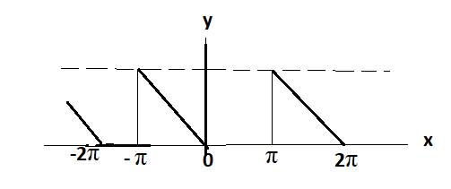
Example 2
Determine the Fourier series to represent the periodic function shown.
f (x+$2π$ ) = f (x) is period = $2π$
f (x) = ̶͟ x ̶ π < x < 0
= 0 0 < x < π
f (x + 2 π) = f (x)

Slide 17
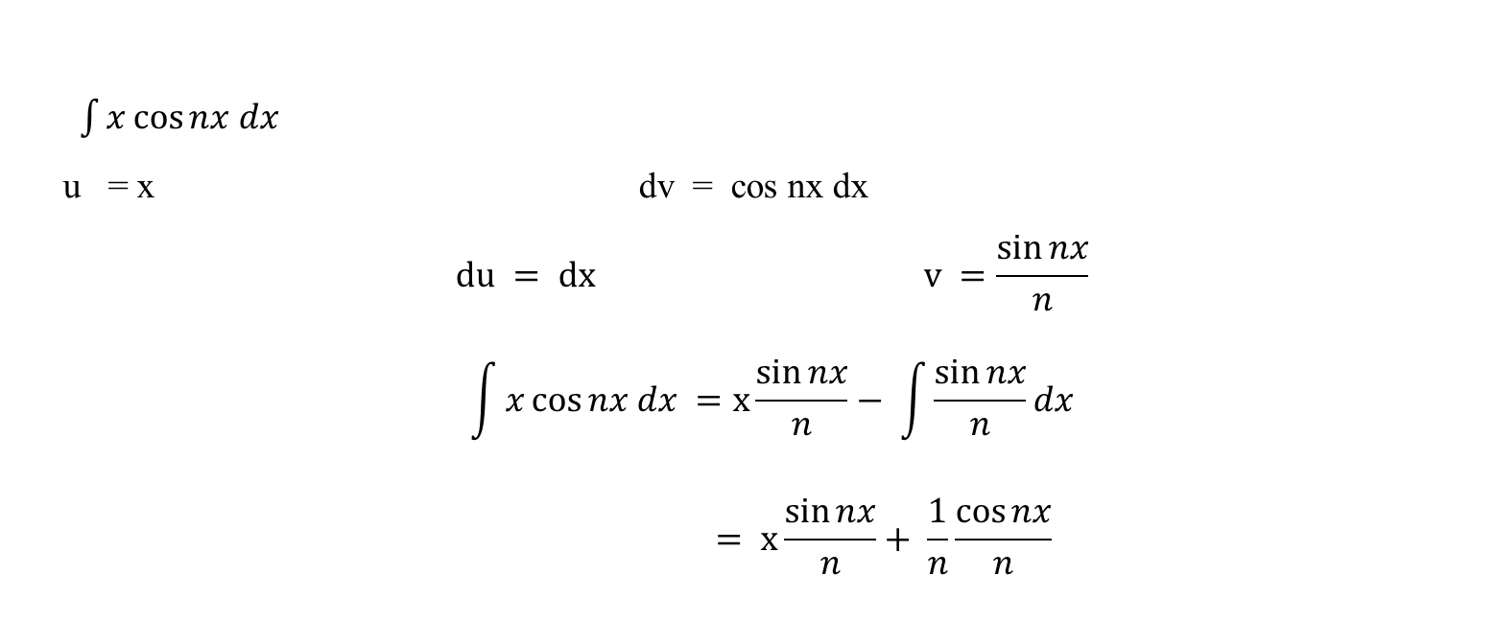
To find the coefficients
$$a_{o}= \frac{1}{π}\int_{0}^{2π}{f\left(x\right)dx= \frac{1}{π}\int_{0}^{2π}{\left(\frac{x}{2}\right)dx= \frac{1}{2π}{\left[\frac{x^{2}}{2}\right]}_{0}^{2π}= \frac{1}{2π}{\left[\frac{x^{2}}{2}\right]}_{0}^{2π}= \frac{1}{2π}{\left[\frac{x^{2}}{2}\right]}_{0}^{2π}= \frac{1}{2π}×\frac{1}{2}×4π^{2} =π}}$$
$$a_{n}= \frac{1}{π}\int_{0}^{2π}{f(x)\cos{nx}dx= \frac{1}{π}\int_{0}^{2π}{\left(\frac{x}{2}\right)\cos{nx}dx= \frac{1}{2π}\int_{0}^{2π}{x\cos{nx dx}}}}$$
$\int{x\cos{nx dx}}$
u = x dv = cos nx dx
$$du = dx v =\frac{\sin{nx}}{n}$$
$$\int{x\cos{nx dx =x\frac{\sin{nx}}{n}− \int{\frac{\sin{nx}}{n}dx}}}$$
$$= x\frac{\sin{nx}}{n}+ \frac{1}{n}\frac{\cos{nx}}{n}$$

Slide 18

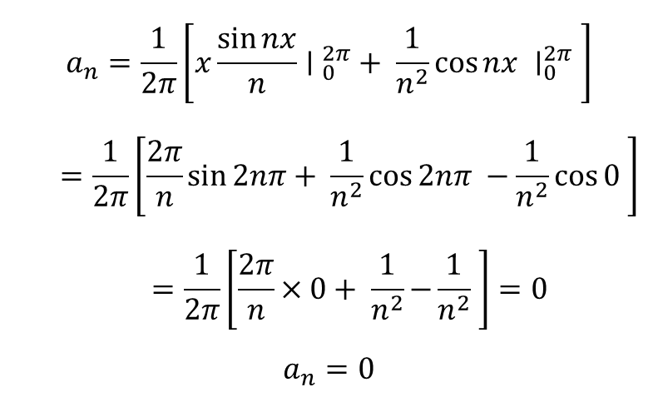
$$a_{n}=\frac{1}{2π}\left[x{\frac{\sin{nx}}{n}∣ }_{0}^{2π}+ \frac{1}{n^{2}}\cos{nx ∣_{0}^{2π}} \right]$$
$$=\frac{1}{2π}\left[\frac{2π}{n}\sin{2nπ}+ \frac{1}{n^{2}}\cos{2nπ −\frac{1}{n^{2}}\cos{0}} \right]$$
$$=\frac{1}{2π}\left[\frac{2π}{n}×0+ \frac{1}{n^{2}}−{\frac{1}{n^{2}}} \right]=0$$
$$a_{n}=0$$
$$b_{n} = \frac{1}{π}\int_{0}^{2π}{f\left(x\right)\sin{nx }dx}$$
$$= \frac{1}{π}\int_{0}^{2π}{(\frac{x}{2})\sin{nx }dx}$$
$$= \frac{1}{2π}\int_{0}^{2π}{x \sin{nx }dx}$$
$$= \frac{1}{2π}\left\{−x {\frac{\cos{nx}}{n}∣}_{0}^{2π} + \int_{0}^{2π}{\cos{nx dx}}\right\}$$
$$= \frac{1}{2π}\left\{−2π \frac{\cos{2nπ}}{n} + {\frac{\sin{nx}}{n}∣}_{0}^{2π}\right\}$$
$$= \frac{1}{2π}\left\{\frac{−2π}{n} + \frac{1}{n}(\sin{2nπ −sin0)}\right\}$$
$$= −\frac{1}{n}$$

Slide 19

a₀ = $π$ a_{n} = 0 b_{n} = $\frac{−1}{n}$
$$f(x) =\frac{a_{0}}{2}+ \sum_{n=1}^{∞}{\left\{a_{n}\cos{nx+b_{n}\sin{nx}}\right\}}$$
$$=\frac{π}{2}+ \sum_{n=1}^{∞}{b_{n}\sin{nx}}$$
$$=\frac{π}{2}+ \left\{−\frac{1}{1}sinx− \frac{1}{2}sin2x− \frac{1}{3}sin3x+…\right\}$$
$$=\frac{π}{2}− \left\{sinx+ \frac{1}{2}sin2x+ \frac{1}{3}sin3x+…\right\}$$

