Slide 1
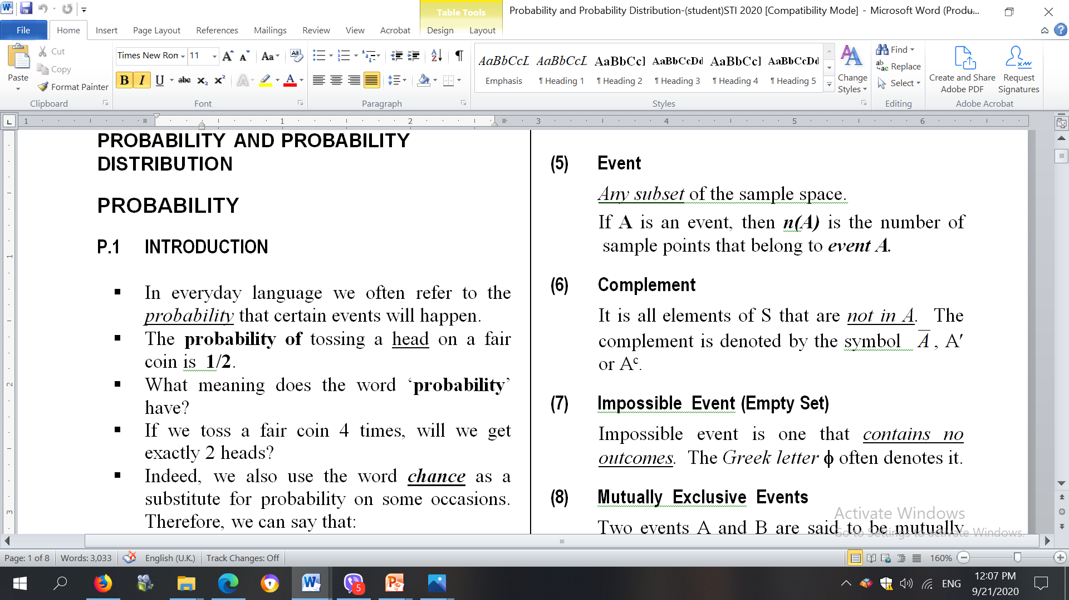

Slide 2
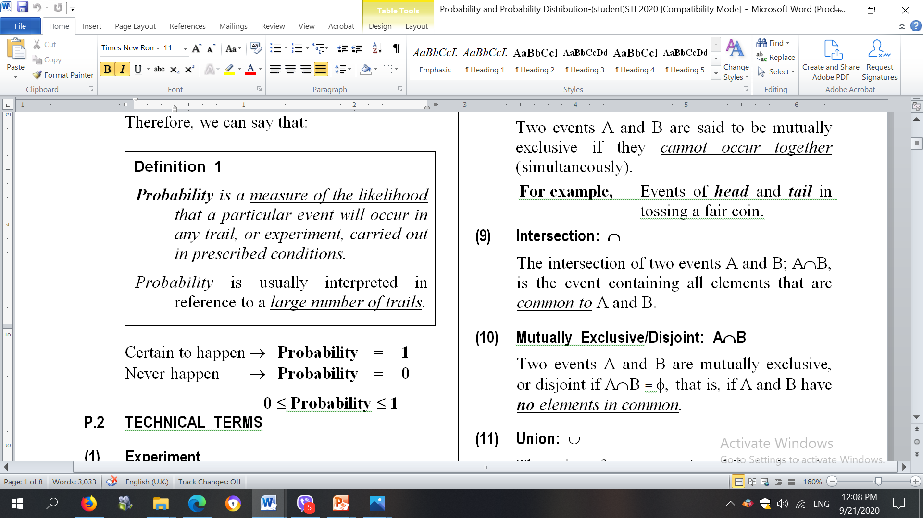

Slide 3
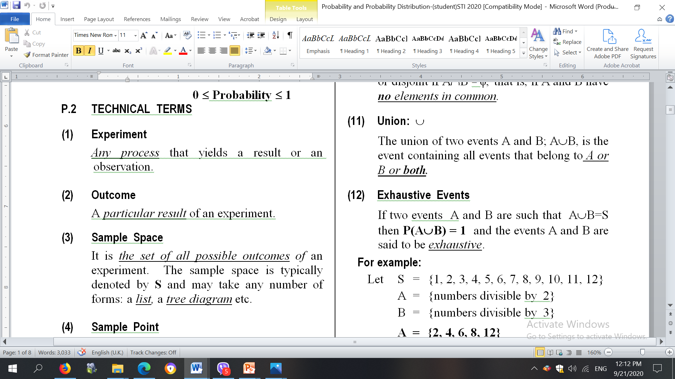

Slide 4
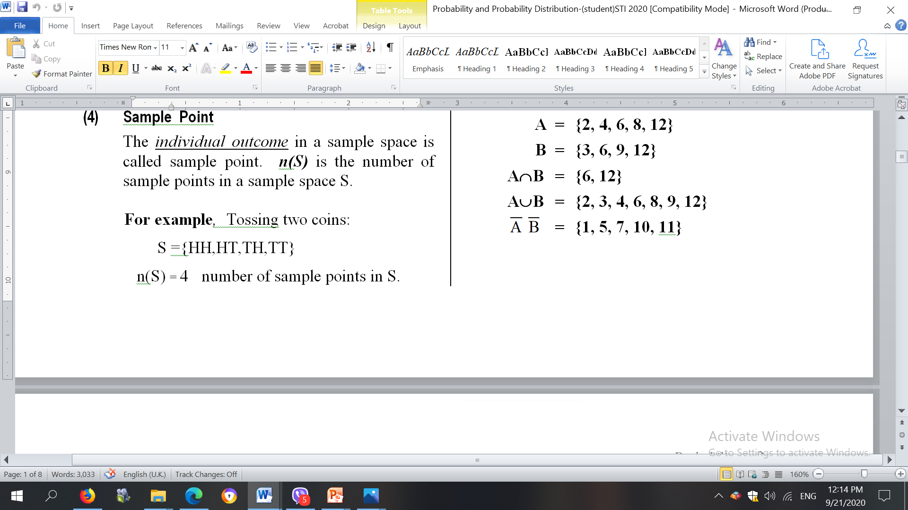

Slide 5
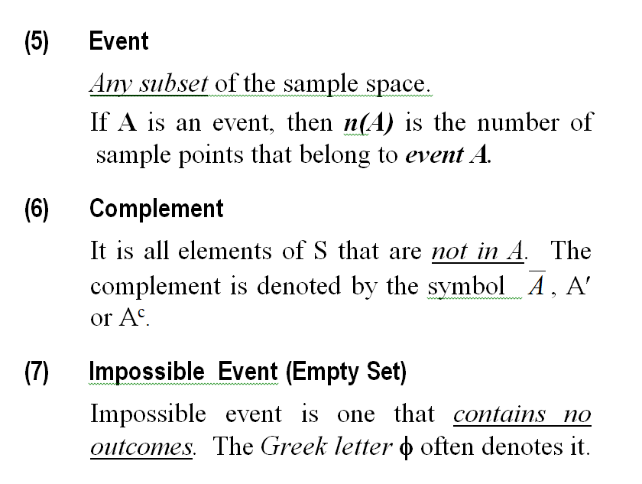

Slide 6
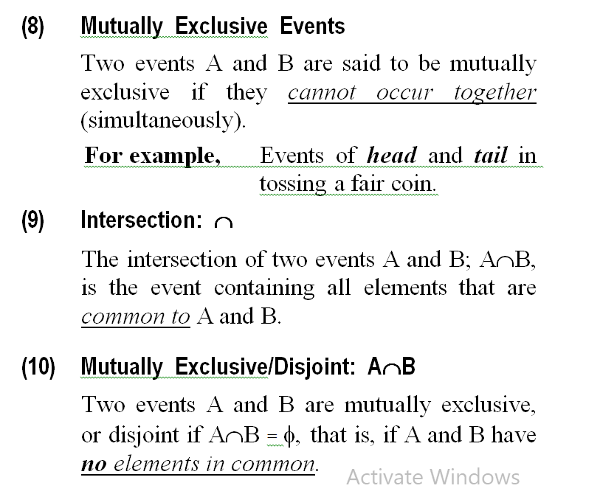

Slide 7
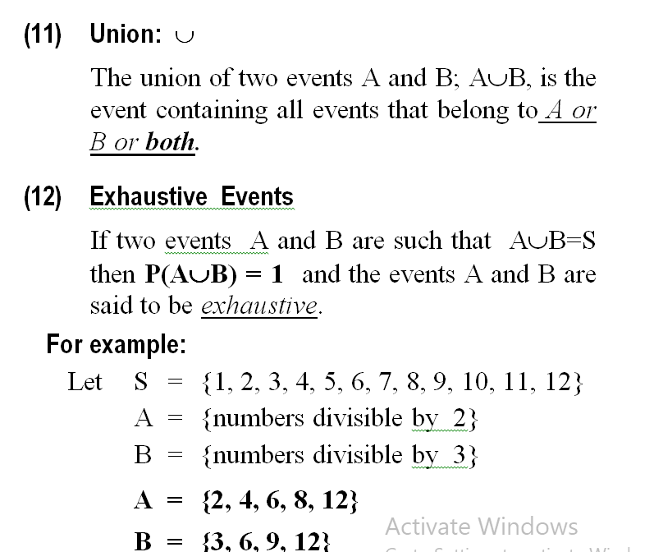

Slide 8
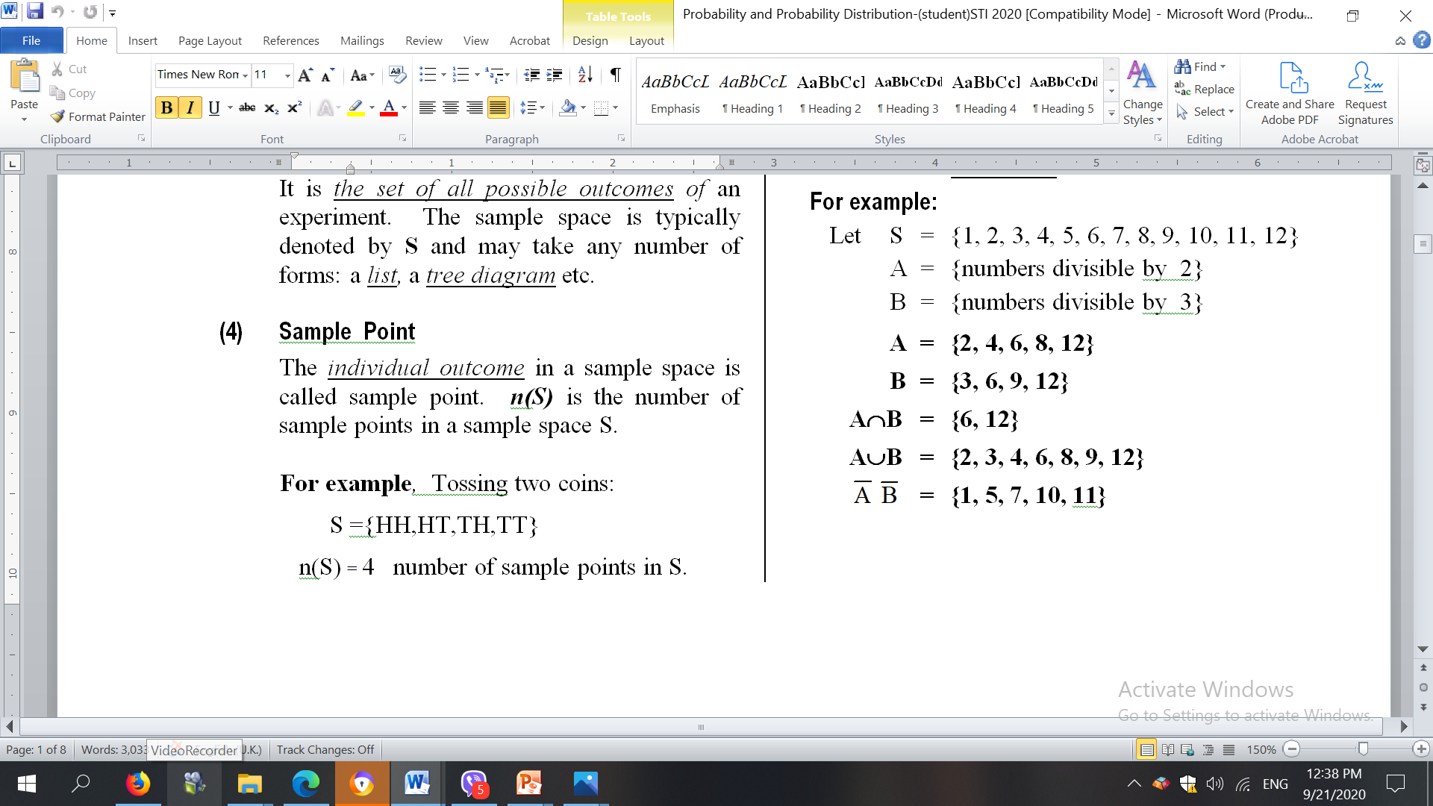

Slide 9
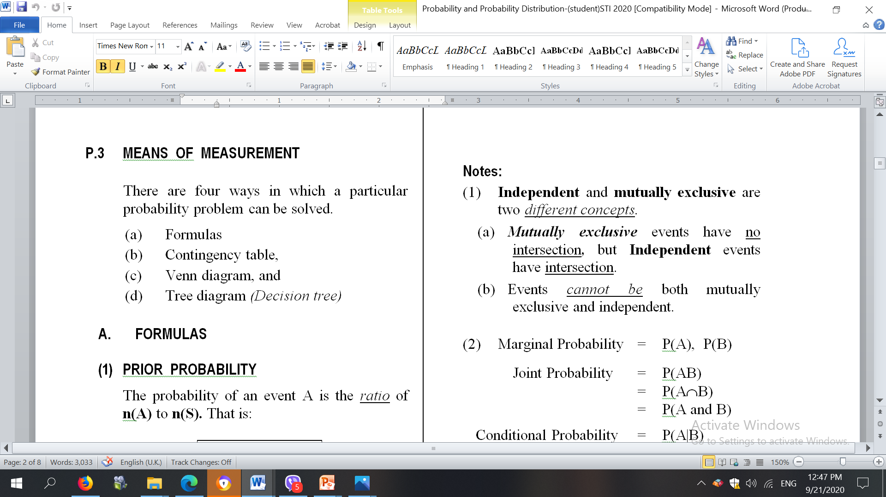
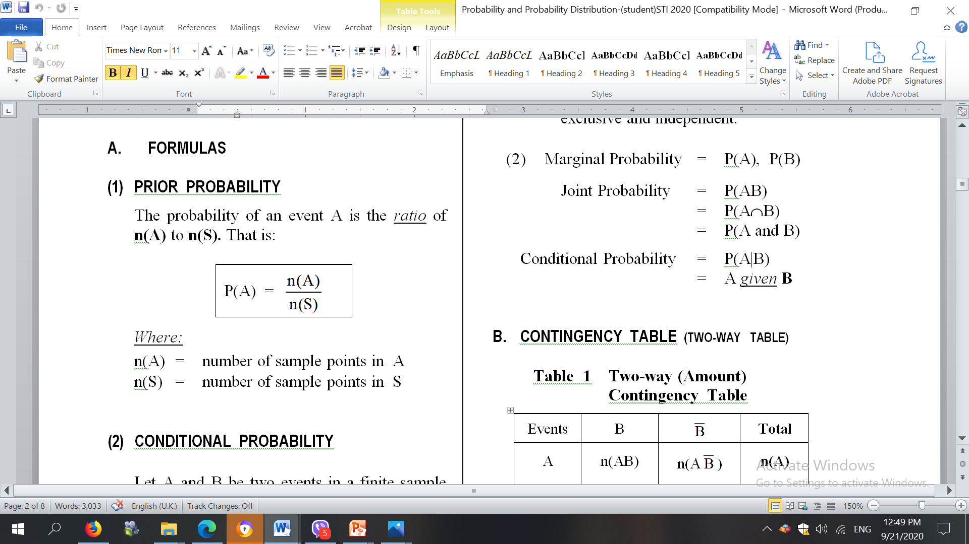

Slide 10

Two coins are tossed. What is the probability that at least one head appears?
= 34
Two coins are tossed
Sample Space S = { HH, HT, TH, TT}
Number of sample points = n(S) = 4
Let A = at least one head appears
Then A = {HH, HT, TH}
n (A) = 3
Therefore P (A) =
= $\frac{3}{4}$

Slide 11
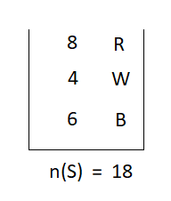







2. A bag contains 8 red, 4 white and 6 black balls, all identical except from colour. If a ball is drawn at random, what is the probability of getting?
a red ball (c) a black ball
a white ball (d) not a white ball
$P\left(R\right)=\frac{n\left(R\right)}{n\left(S\right)}$ = $\frac{8}{18}$ = $\frac{4}{9}$
(b) $P\left(B\right)=\frac{n(B)}{n(S)}$ = $\frac{6}{18}$ = $\frac{1}{3}$
$\left(c \right)P\left(W\right)=\frac{n(W)}{n(S)}$ = $\frac{4}{18}$ = $\frac{2}{9}$
$$= \frac{\left. n\left(R\right)+n(B\right)}{\left.n(S\right)}$$
= $\frac{8+6}{18}$ = $\frac{14}{18}=\frac{7}{9}$
(d)$P\left(not W\right)=P\left(\overline{W}\right)$
Now we have
P(W) + P($\overline{W}$) = $\frac{2}{9}$ + $\frac{7}{9}$ = 1
In general P(A) + P(A) = 1

Slide 12
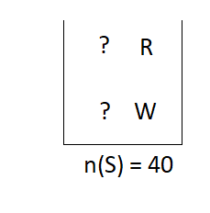




3. A box contains 40 discs, identical except that some are red and the rests are white. If a disc is drawn at random, the probability that it is red is 1/4.
(a) How many white discs are there in the box?
(b) How many more red discs should be put into the box to make the probability of drawing a red disc = 1/3.
Given P(R) = $\frac{1}{4}$
n(W) = ?
P( R ) = $\frac{n\left(R\right)}{n\left(S\right)}$
$\frac{1}{4}$= $\frac{n\left(R\right)}{40}$
n( R) = $\frac{1}{4} x 40$ = 10
Therefore n(W ) = 40 ̶ 10 =30

Slide 13
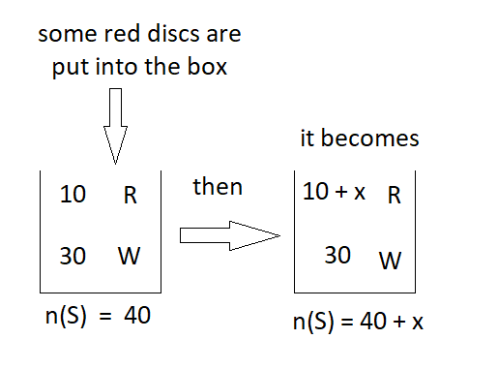



(b) Some red discs are put into the box, let it be x
P ( R) = $\frac{1}{3}$
P ( R ) =$\frac{n(R)}{n(S)}$ = $\frac{10+X}{40+X}$
1/3 = $\frac{10+X}{40+X}$
30 + 3x = 40 + x
x = 5

Slide 14
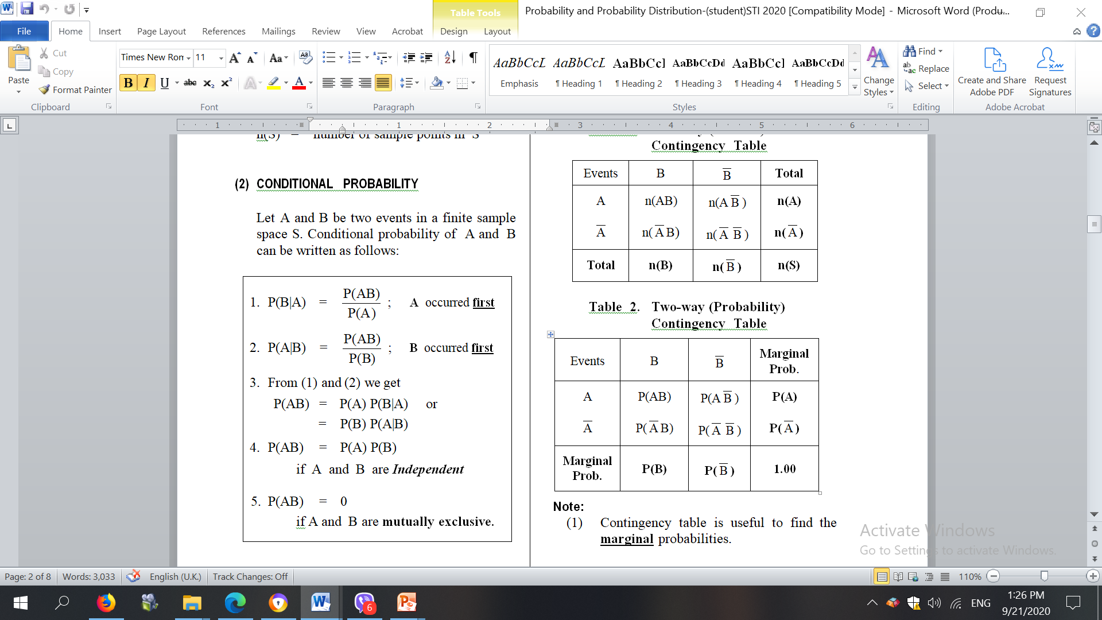

Slide 15
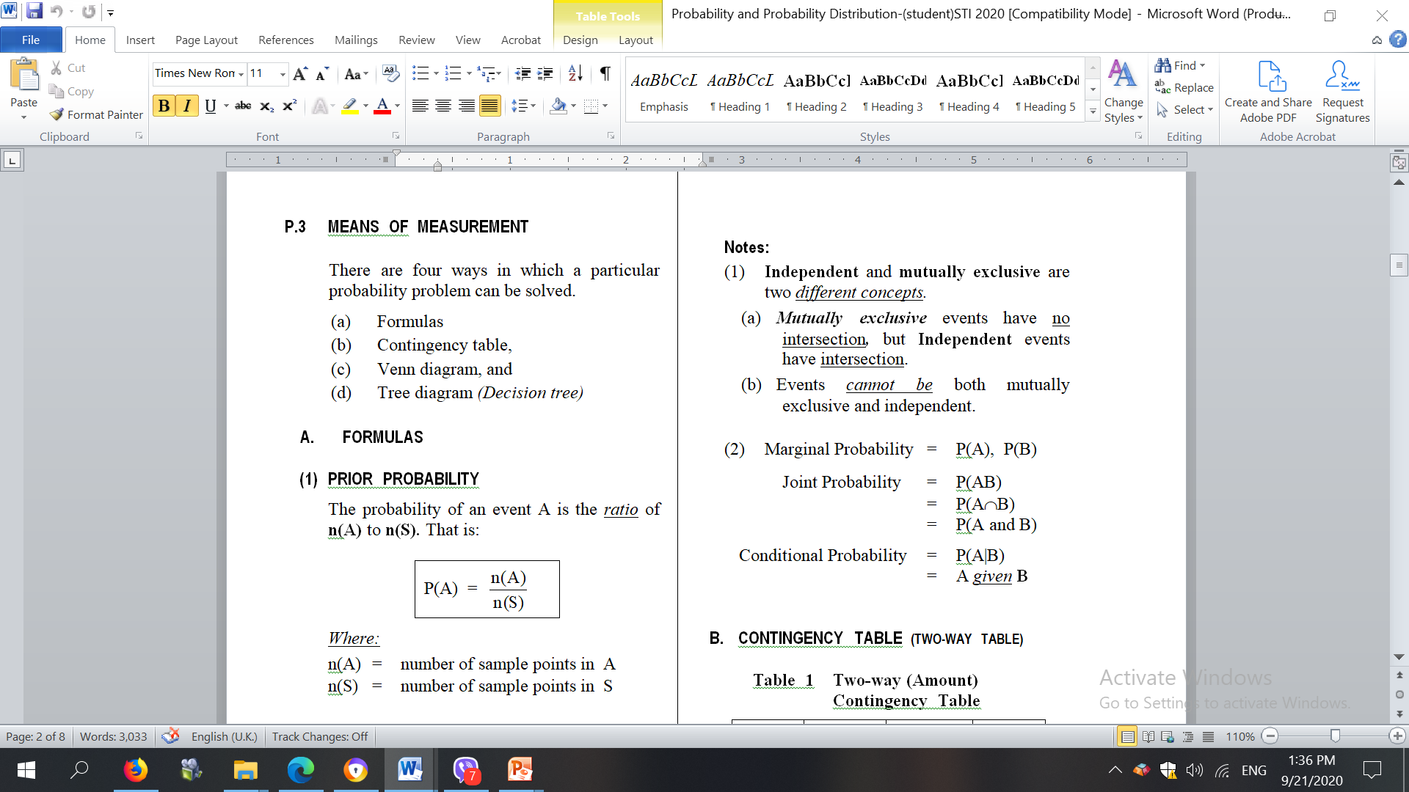

Slide 16
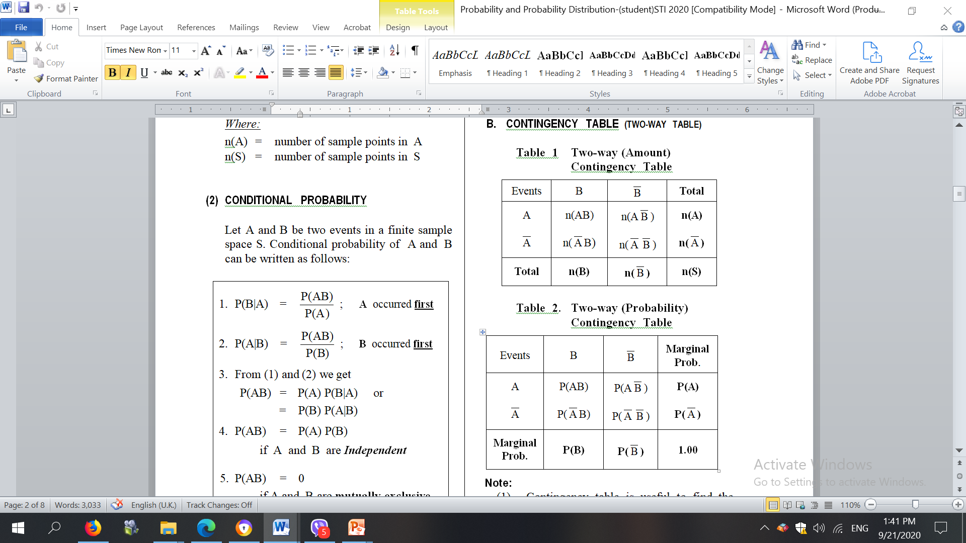

Slide 17
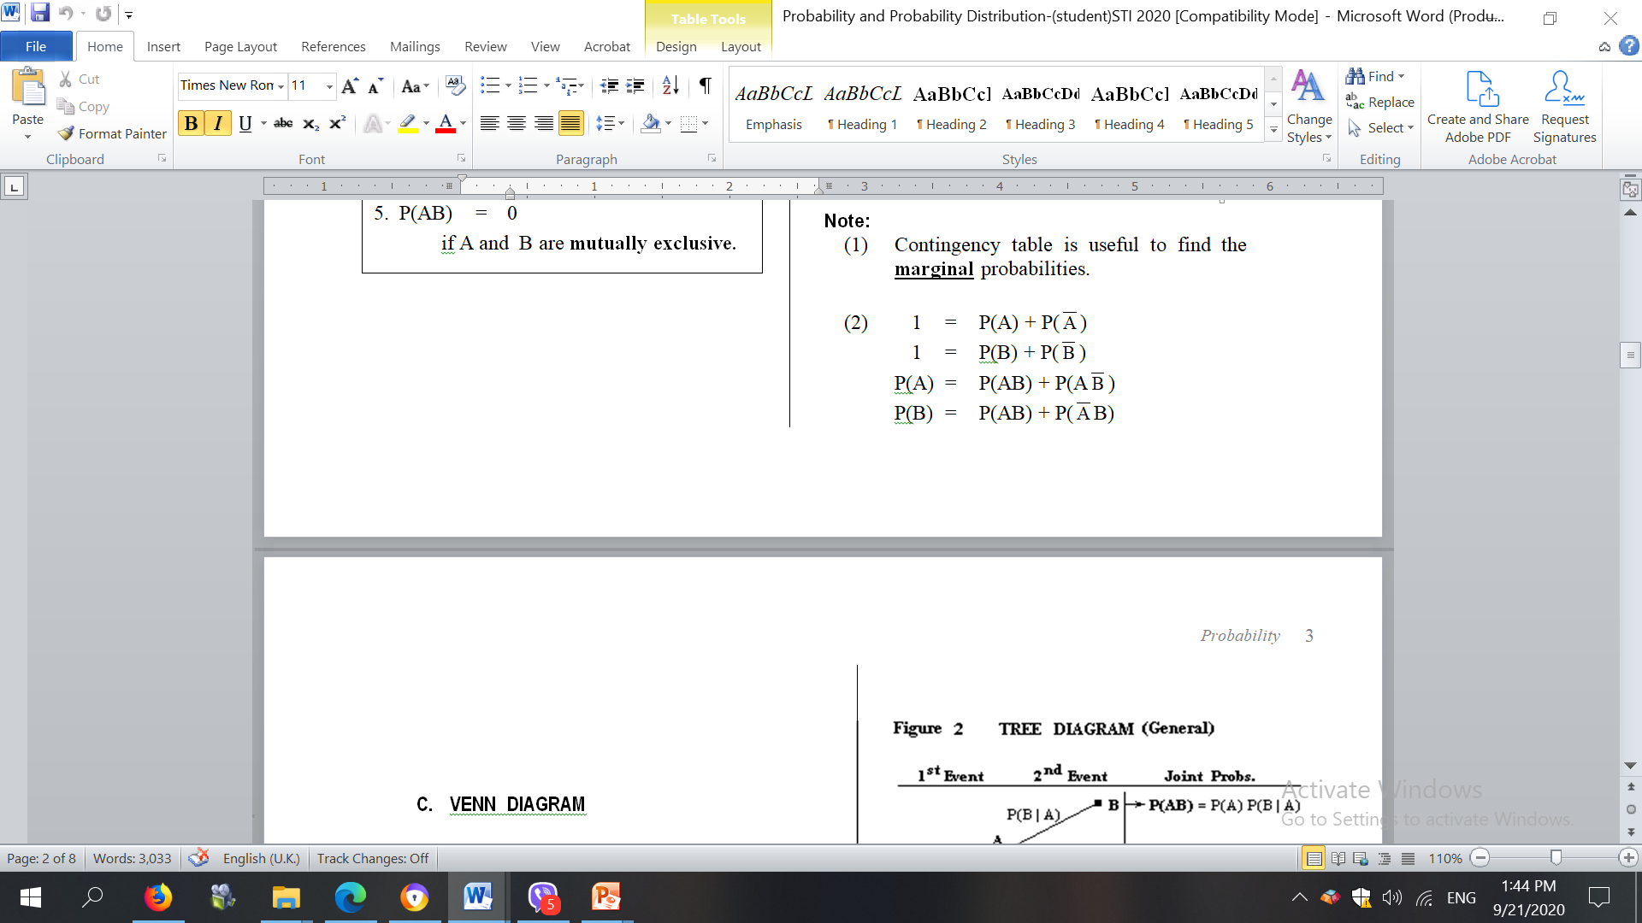

Slide 18
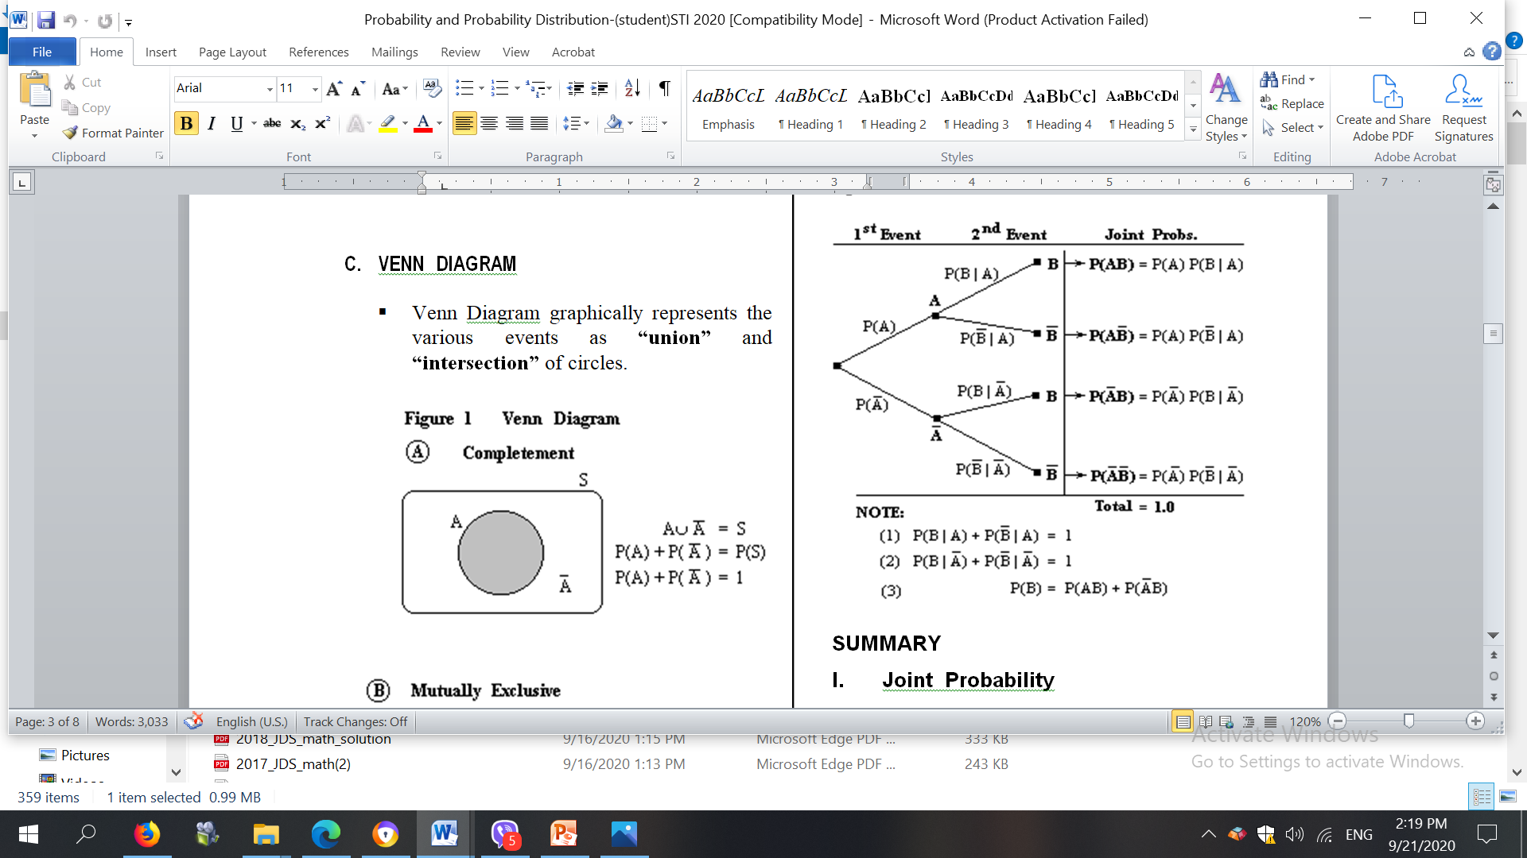

Slide 19
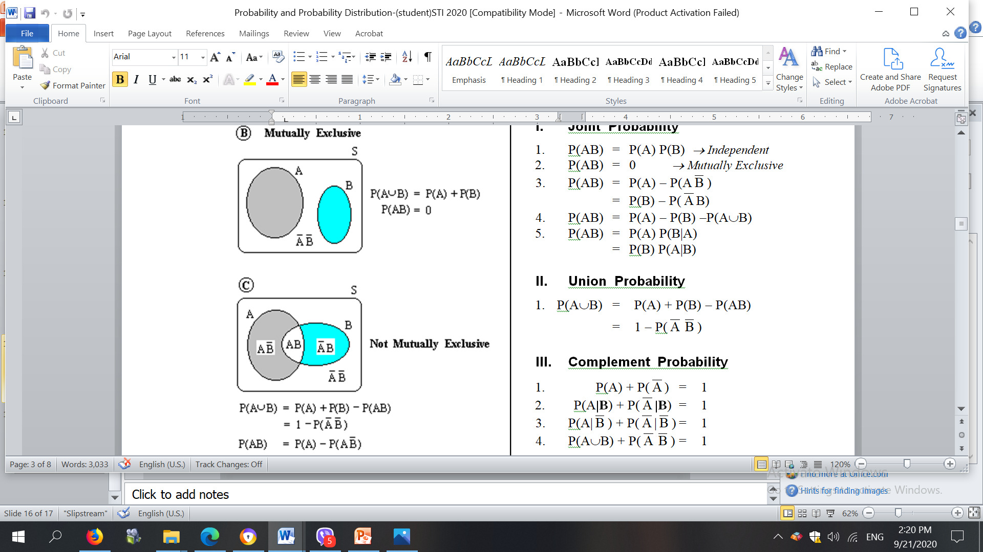

Slide 20
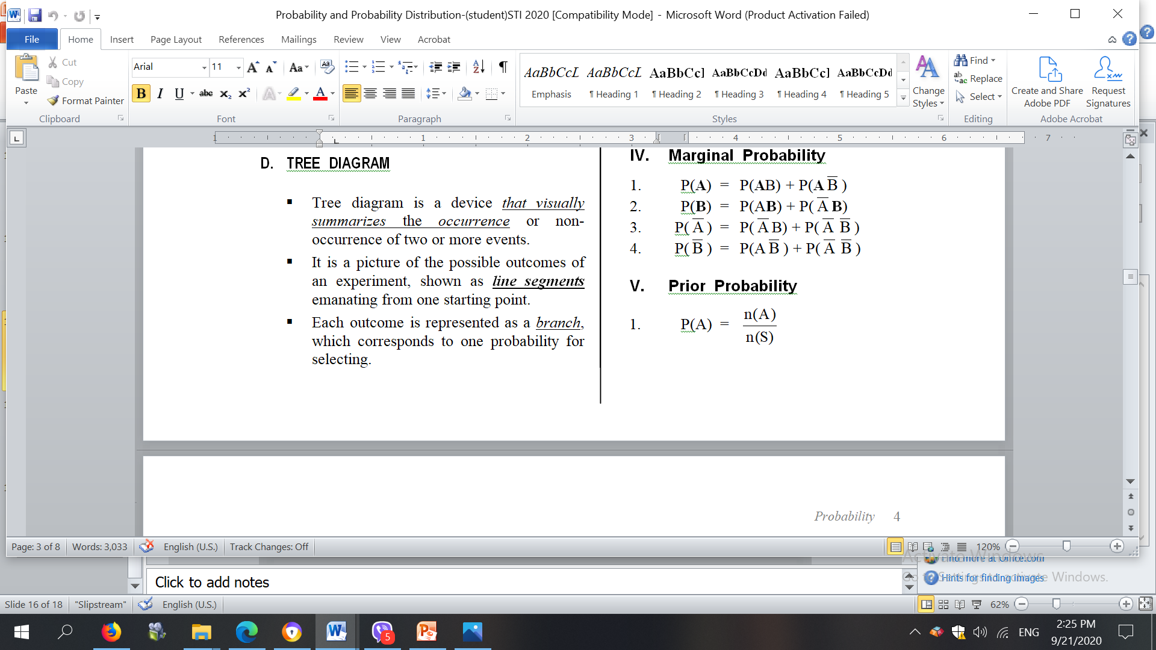

Slide 21
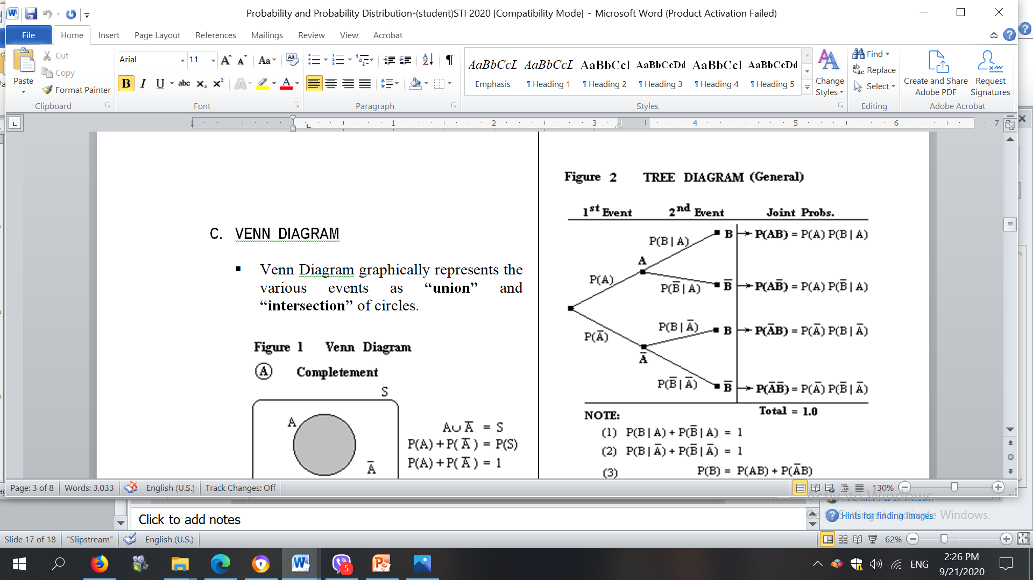

Slide 22
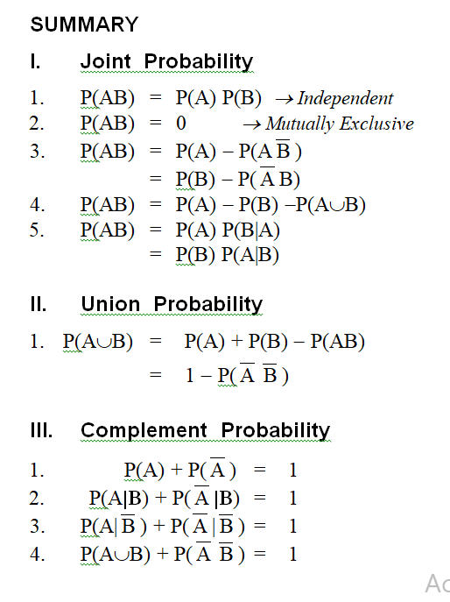

Slide 23
